Slide 1
Lab Seminar
2024.05.27
16:00(UTC+9)
Seungwan Woo (UST)

Slide 2
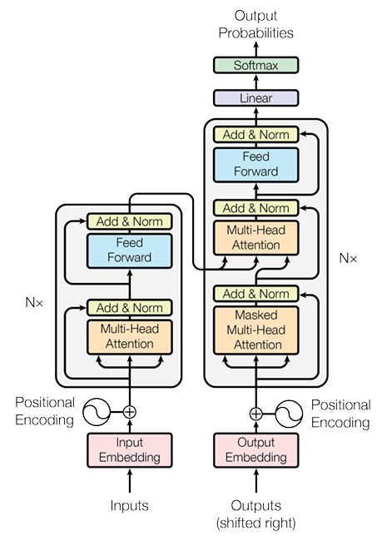
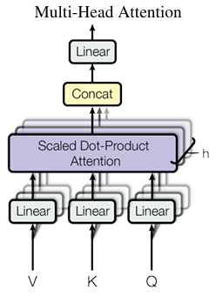
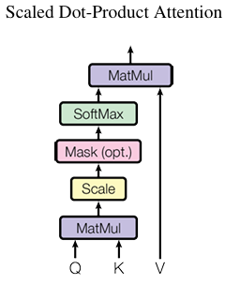
Vaswani, A., Shazeer, N., Parmar, N., Uszkoreit, J., Jones, L., Gomez, A. N., ... & Polosukhin, I. (2017). Attention is all you need. Advances in neural information processing systems, 30.
Background

Slide 3
Vaswani, A., Shazeer, N., Parmar, N., Uszkoreit, J., Jones, L., Gomez, A. N., ... & Polosukhin, I. (2017). Attention is all you need. Advances in neural information processing systems, 30.
Background
Decoder
Encoder

Slide 4
Vaswani, A., Shazeer, N., Parmar, N., Uszkoreit, J., Jones, L., Gomez, A. N., ... & Polosukhin, I. (2017). Attention is all you need. Advances in neural information processing systems, 30.
Background – Positional encoding
Positional Encoding
+
+
+
+
+
Input Embedding
nice
to
meet
you
nice
to
meet
you

Slide 5
Vaswani, A., Shazeer, N., Parmar, N., Uszkoreit, J., Jones, L., Gomez, A. N., ... & Polosukhin, I. (2017). Attention is all you need. Advances in neural information processing systems, 30.
Background – Query, Key, Value
Query: Currently processing token vector.
Key: A vector use to measure the similarity between the query and each token
Value: Vector used to calculate the token’s weight based on Attention Score
Attention!
Value
The
animal
didn’t
cross
the
street
because
it
was
to
tired
Attention Score
The
animal
didn’t
cross
the
street
because
it
was
to
tired
Key
The
animal
didn’t
cross
the
street
because
it
was
to
tired
Token
The
animal
didn’t
cross
the
street
because
it
was
to
tired
Query #8

Slide 6
Vaswani, A., Shazeer, N., Parmar, N., Uszkoreit, J., Jones, L., Gomez, A. N., ... & Polosukhin, I. (2017). Attention is all you need. Advances in neural information processing systems, 30.
Background – Multi-Head Attention
Multi-Head Attention
Which do you like better, coffee or tea?
Attention on sentence type
Which do you like better, coffee or tea?
Attention on noun
Which do you like better, coffee or tea?
Attention on relationship
Which do you like better, coffee or tea?
Attention on emphasis

Slide 7
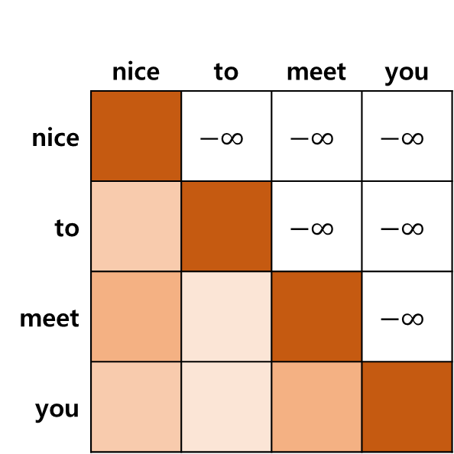
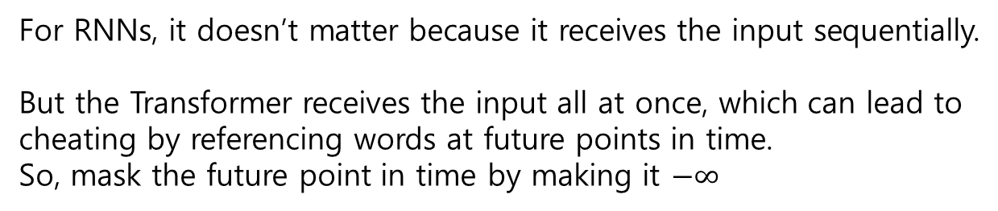
Vaswani, A., Shazeer, N., Parmar, N., Uszkoreit, J., Jones, L., Gomez, A. N., ... & Polosukhin, I. (2017). Attention is all you need. Advances in neural information processing systems, 30.
Background – Masked Attention
Masked Attention
For RNNs, it doesn’t matter because it receives the input sequentially.
But the Transformer receives the input all at once, which can lead to cheating by referencing words at future points in time.
So, mask the future point in time by making it $−∞$
 | nice | to | meet | you
nice |  | $$−∞$$ | $$−∞$$ | $$−∞$$
to |  |  | $$−∞$$ | $$−∞$$
meet |  |  |  | $$−∞$$
you

Slide 8
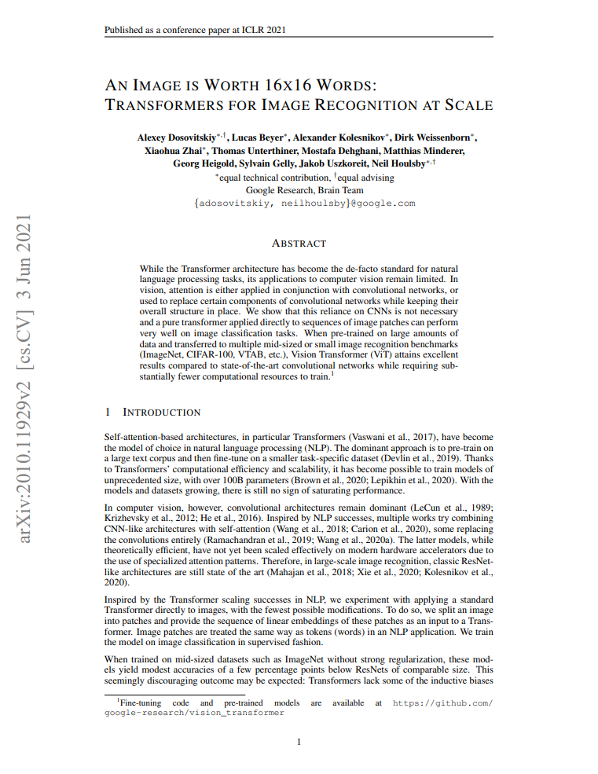
Introduction
AN IMAGE IS WORTH 16X16 WORDS: TRANSFORMERS FOR IMAGE RECOGNITION AT SCALE
ICLR 2021
Google Brain
Citation: 35,335

Slide 9
Introduction
Michelucci, Umberto. "An introduction to autoencoders." arXiv preprint arXiv:2201.03898 (2022).
The Transformers has become the de-facto standard in NLP.
However, CNN remains dominant in Computer vision.
Inspired by the Transformer success in NLP, the authors apply a standard Transformer to image classification in Computer vision.
To do so, authors are split an image into patches and provide the sequence of linear embeddings of these patches as an input to a Transformer.
This is same way as tokens(words) in an NLP application.

Slide 10
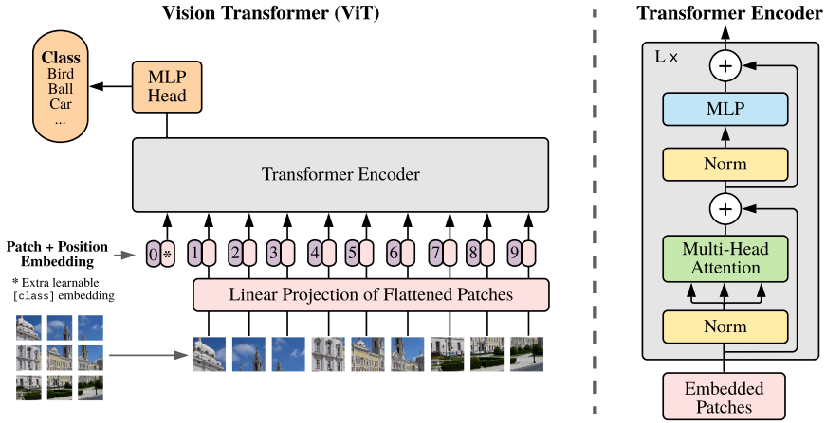
Dosovitskiy, Alexey, et al. "An image is worth 16x16 words: Transformers for image recognition at scale." arXiv preprint arXiv:2010.11929 (2020).
Method

Slide 11










Dosovitskiy, Alexey, et al. "An image is worth 16x16 words: Transformers for image recognition at scale." arXiv preprint arXiv:2010.11929 (2020).
Method
<Input>
Reshaping
(255X255X3)
9(85X85X3)

Slide 12
Dosovitskiy, Alexey, et al. "An image is worth 16x16 words: Transformers for image recognition at scale." arXiv preprint arXiv:2010.11929 (2020).
Method
1
2
3
4
5
6
7
8
9
9(85X85X3)
1
2
3
4
5
6
7
8
9

Slide 13
Dosovitskiy, Alexey, et al. "An image is worth 16x16 words: Transformers for image recognition at scale." arXiv preprint arXiv:2010.11929 (2020).
Method
9
8
7
4
6
1
5
2
3
9XD
1
2
3
4
5
6
7
8
9

Slide 14
Dosovitskiy, Alexey, et al. "An image is worth 16x16 words: Transformers for image recognition at scale." arXiv preprint arXiv:2010.11929 (2020).
Method
0
class token
9
8
7
4
6
1
5
2
3
(9+1)XD
1
2
3
4
5
6
7
8
9

Slide 15
Dosovitskiy, Alexey, et al. "An image is worth 16x16 words: Transformers for image recognition at scale." arXiv preprint arXiv:2010.11929 (2020).
Method
0
class token
9
6
8
4
7
1
5
2
3
(9+1)XD
Patch embedding
10XD
Patch + Positional embedding
(9+1)XD
Positional embedding

Slide 16
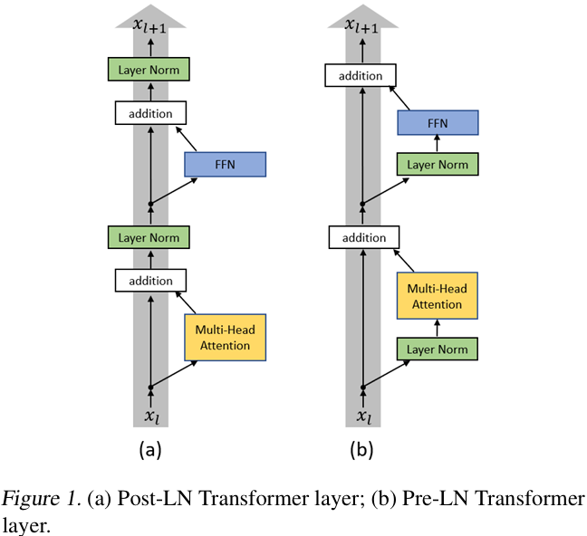
Xiong, Ruibin, et al. "On layer normalization in the transformer architecture." International Conference on Machine Learning. PMLR, 2020.
Method
Why does ViT uses pre-LN?

Slide 17
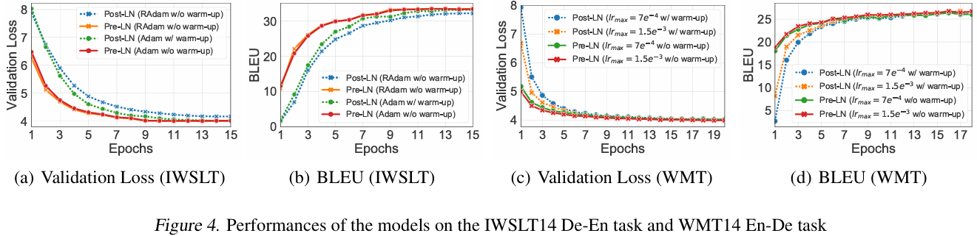
Xiong, Ruibin, et al. "On layer normalization in the transformer architecture." International Conference on Machine Learning. PMLR, 2020.
Method
Because pre-LN is faster than pro-LN and doesn’t require a warm-up in learning rate!
Learning rate warm-up: A technique for slowly increasing the learning rate during the initial training phase of a deep learning model. It is used because a high initial training rate can lead to inaccurate predictions.

Slide 18
Dosovitskiy, Alexey, et al. "An image is worth 16x16 words: Transformers for image recognition at scale." arXiv preprint arXiv:2010.11929 (2020).
Method
10XD
Patch + Positional embedding
10XD
Normalized embedding

Slide 19
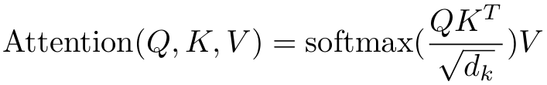
Dosovitskiy, Alexey, et al. "An image is worth 16x16 words: Transformers for image recognition at scale." arXiv preprint arXiv:2010.11929 (2020).
Method
10XD
Normalized embedding
10XD
Query
10X10
Attention score
10XD
Key
10XD
Self-Attention Value
10XD
Value

Slide 20
Dosovitskiy, Alexey, et al. "An image is worth 16x16 words: Transformers for image recognition at scale." arXiv preprint arXiv:2010.11929 (2020).
Method
Norm
MLP
10XD
Self-Attention Value
Class token
(9+1)XD
Transformer Output

Slide 21
Dosovitskiy, Alexey, et al. "An image is worth 16x16 words: Transformers for image recognition at scale." arXiv preprint arXiv:2010.11929 (2020).
Method
Classification using only the Class token
MLP
Bird
Class token
(9+1)XD
Transformer Output

Slide 22
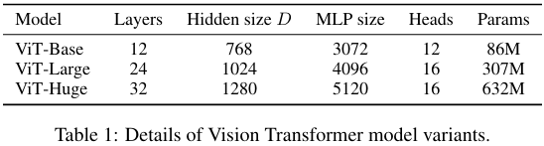
Dosovitskiy, Alexey, et al. "An image is worth 16x16 words: Transformers for image recognition at scale." arXiv preprint arXiv:2010.11929 (2020).
Experience

Slide 23
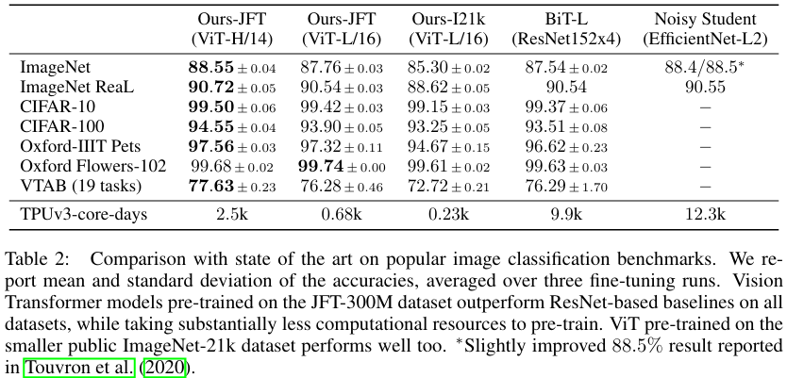
Dosovitskiy, Alexey, et al. "An image is worth 16x16 words: Transformers for image recognition at scale." arXiv preprint arXiv:2010.11929 (2020).
Experience
Patch size

Slide 24
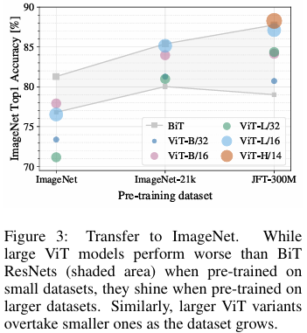
Dosovitskiy, Alexey, et al. "An image is worth 16x16 words: Transformers for image recognition at scale." arXiv preprint arXiv:2010.11929 (2020).
Experience
Dataset | Classes | Images
ImageNet | 1k | 1.3M
ImageNet-21k | 21k | 14M
JFT | 18k | 303M
Why does ViT require more data?
-> Because it lacks inductive bias compared to CNN!

Slide 25
Dosovitskiy, Alexey, et al. "An image is worth 16x16 words: Transformers for image recognition at scale." arXiv preprint arXiv:2010.11929 (2020).
Experience
CNN
5
1 | 2 | 3
4 | 5 | 6
7 | 8 | 9
1
2
3
4
5
6
7
8
9
Beak detection
ViT

Slide 26
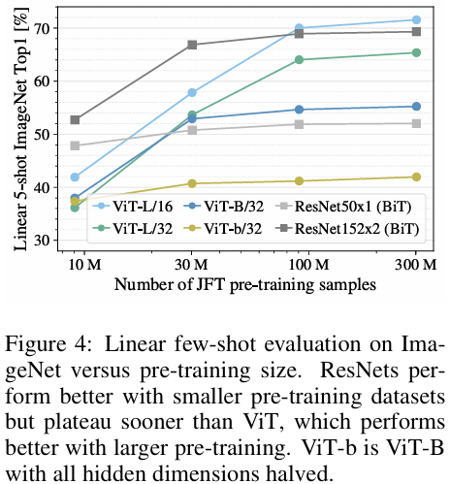
Dosovitskiy, Alexey, et al. "An image is worth 16x16 words: Transformers for image recognition at scale." arXiv preprint arXiv:2010.11929 (2020).
Experience

Slide 27
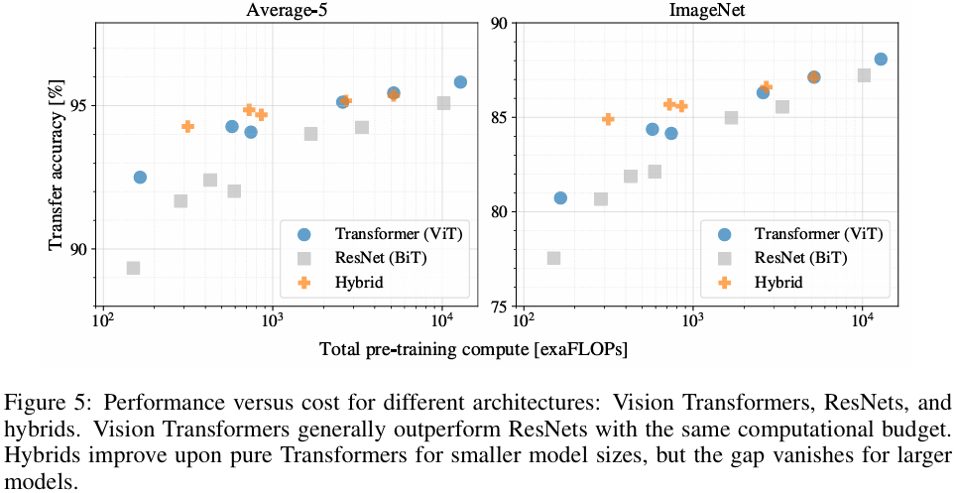
Dosovitskiy, Alexey, et al. "An image is worth 16x16 words: Transformers for image recognition at scale." arXiv preprint arXiv:2010.11929 (2020).
Experience
Image
convolution
ViT
Hybrid
input

Slide 28
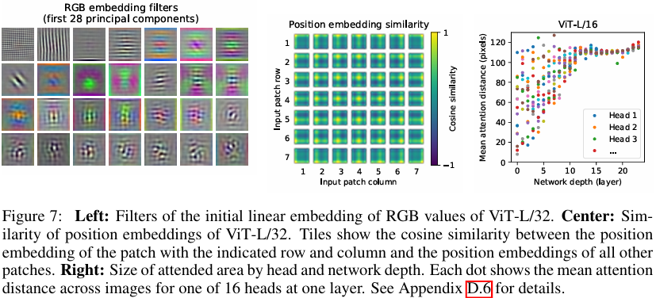
Dosovitskiy, Alexey, et al. "An image is worth 16x16 words: Transformers for image recognition at scale." arXiv preprint arXiv:2010.11929 (2020).
Experience

Slide 29
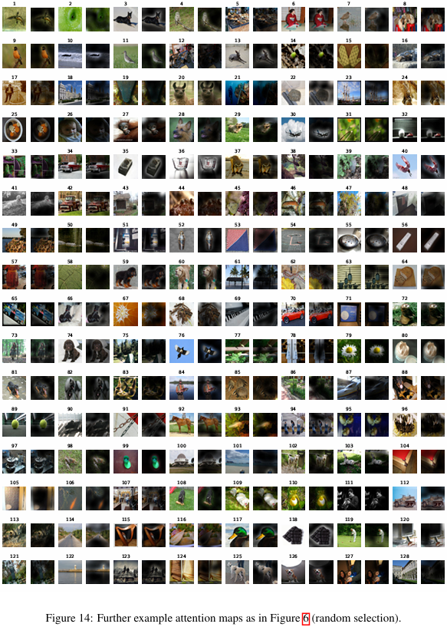
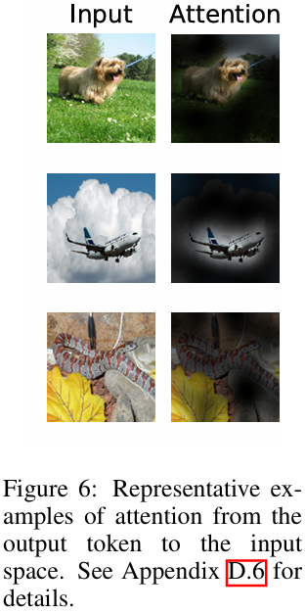
Dosovitskiy, Alexey, et al. "An image is worth 16x16 words: Transformers for image recognition at scale." arXiv preprint arXiv:2010.11929 (2020).
Experience

Slide 30
Conclusion
Why I reviewed this paper?
Transformer and ViT are very important papers in NLP and vision.
They are used in many studies, and I reviewed them as a background study to make it easier to understand the papers.
I wish to do research on data generation for learning. Because I think we can learn from data generated in situations where there is limited data to apply AI in various fields.

Slide 31
Thank you!

